Slide 1

Scottish Rite Foundation of Colorado
February 25, 2022
2021 Annual Report
Notes:
I am excited to have the opportunity to review of the outstanding care of children and families thanks to dedicated clinicians throughout our state as well as the immeasurable contributions of Scottish Rite Masons and our guests to achieve these efforts.
This work began in 1953, when one social worker contacted the almoner of the Denver consistory there was a little boy who needed speech therapy but this single mother couldn’t afford it. Which led to the beginning of a remarkable relationship and commitment to the serve more than 22,000 children of across the state of CO that we will hear about today.

Slide 2
2020 Year in Review
Statistical Summary
  RiteCare© Clinical Programs
  Treasure Chest Language/Pre-Literacy Programs
2020 – 2021 Scholars
RiteCare© Program Changes in 2020
Report from the Executive Secretary
Notes:
During this brief presentation I will provide a statistical summary of the work of the Foundation partner programs in speech-language and learning therapy services, the RiteCare Clinical programs, as well as the important work of our partners in early childhood language and literacy development, the Treasure Chest programs. I will mention some transitions in our programs, and introduce you to the 2020-2021 Dwight A Hamilton Scottish Rite Masons Graduate Student Scholarships in Speech-language pathology. Finally, Bryant Harris will highlight the Foundations 67 years of impact on the state of CO.

Slide 3
CHILDREN SERVED - RITECARE© CLINICAL PROGRAMS
Clinical programs provide individual and/or group speech-language or learning therapy to children with identified delays secondary to conditions such as autism, cleft palate, cerebral palsy, deafness, developmental delay, head injury or learning disabilities.
Program | 2019 | 2020 | Difference
Children’s Hospital Colorado (metro) | 283 | 224 | -59
Children’s Hospital Colorado (Pueblo) | 50 | 21 | -29
Children’s Hospital (Colorado Springs) | 14 | 33 | 19
St. Mary’s Grand Junction | 75 | 65 | -10
Memorial Regional Health-Craig Colorado | 4 | 6 | 2
Memorial-Montrose | 17 | 26 | 9
Children’s Speech and Reading- Ft. Collins | 154 | 109 | -45
Gunnison Valley Health | 4 | 8 | 4
University of Colorado-Boulder | 26 | 15 | -12
University of Northern Colorado-Greeley | 16 | 12 | -4
Total | 643 | 519 | -124
Notes:
Likely due to the COVID 19 pandemic, there was a decrease in the number of children who received speech-language or learning clinical services with SRF support at partner programs throughout the state.
In 2020 519 children benefited from Foundation support for these services, this was a decrease of 124 children this year.

Slide 4
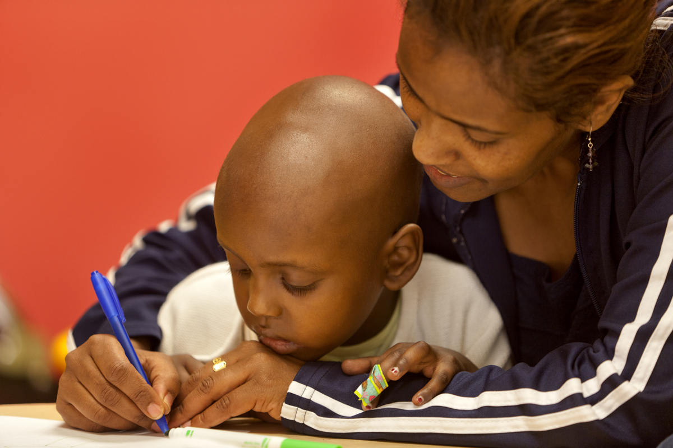
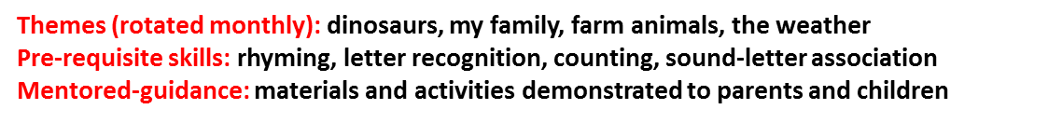
CHILDREN AND FAMILIES SERVED –
TREASURE CHEST PROGRAMS
Treasure Chest Programs are preschool, pre-literacy programs bringing theme-based high-quality books, toys, and creative play activities to youngsters at-risk of entering kindergarten without pre-requisite skills for language and literacy development. Families receive mentored guidance on using the materials with their children and commit to spending time each day in active learning with their child/children.
Program | 2019 | 2020 | Difference
The Piñon Project-Cortez | 183 | 144 | -39
Rocky Mountain SER Head Start | 98 | N/A | -98
UNC | 57 | 200 | 143
Total | 338 | 344 | 6
Notes:
This year 344 children were served by the Foundation-supported preschool, preliteracy programs. 144 children received this service in Cortez and its surrounding communities in Southern CO at the Piñon project and due to programmatic changes and 200 at UNC this year. These programs provide ”chests” that are theme-based books, toys,
creative play activities for children
at risk of entering kindergarten without the prerequisite skills for language and literacy development. Families receive mentored advice on using the materials with their children and commit to spending time each day in active learning with their children.

Slide 5
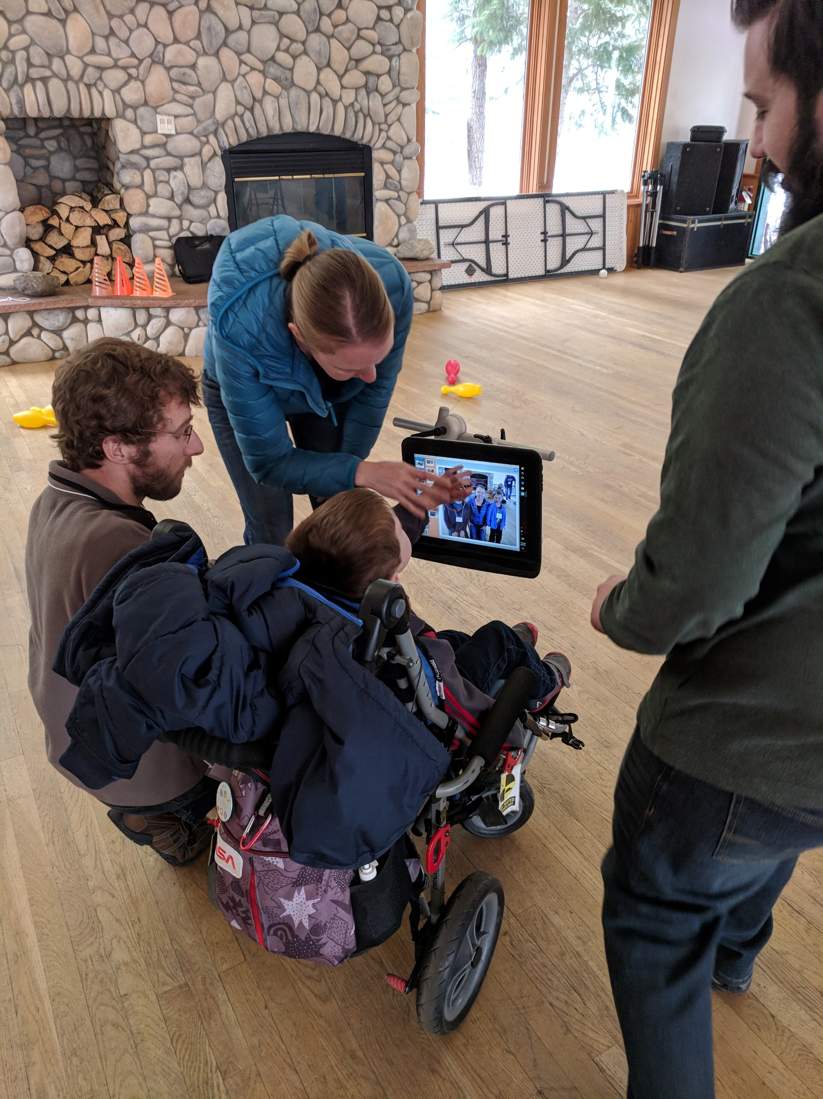
Camp Programs
 | 2019 | 2020 | Difference
Talking with Technology | 28 | Cancelled
First Steps Camp | 14 | 4 | -10
Support Provided by: Rollie R. Kelley Family Foundation and Scottish Rite Foundation
Due to COVID 19, TWT and Spring First steps camps were cancelled, BUT Fall FSC went virtual
Notes:
For the health and safety of participants and staff, Spring FSC and TWT 2020 and 2021 have been cancelled.
First Steps Camp is a Family Education and Experience Program. This is an extended weekend long camp for children and their families who may have recently received their Augmentative and Alternative Communication (AAC) device, or are waiting to receive it, and are just now entering into the world of “technology for communication”
AS I mentioned there has been tremendous creativity this year, leading to a virtual FSC in the fall and development of video snipits that will allow families from across the state to benefit from the First steps camp experience
Out of my mind by Draper, this little girl named Melody had a photographic memory
Wonder Auggie Pullman many surgeries, bullies,
Speechless, and I feel it highlights the needs for AAC communication and illustrates examples, in a humorous light, the challenges families face
TWT Camp is given to children who come with an adult who is working with the child and his/her system (e.g., speech therapist, teacher, aide, etc.), but is not a family member.

Slide 6
FINANCIAL SUPPORT AND
AVERAGE COST PER CHILD
Program | $Contributed | # Served | Cost/Child/Year
RiteCare© Clinical Programs | $1,268,699 | 519 | $2,455*
Treasure Chest Programs | $168,520 | 344 | $429**
Total | $1,437,219 | 863 | $1,647
*Relative to 2019, an increase of approximately $807/child ($1,642/child)
** Relative to 2019, an increase of approximately $111/child ($378/child)
For average cost per child by individual program, please review each RiteCare© or Treasure Chest Program Annual Report on the Scottish Rite Foundation of Colorado website: www.scottishritefoundation.org
Notes:
The average cost for individual therapy was $1,642, this was an increase in therapy from 2019 of $807. The average cost for the Treasure Chest program per child was $429 per child, an increase of $111. A relatively small investment for a lifetime of language and learning

Slide 7
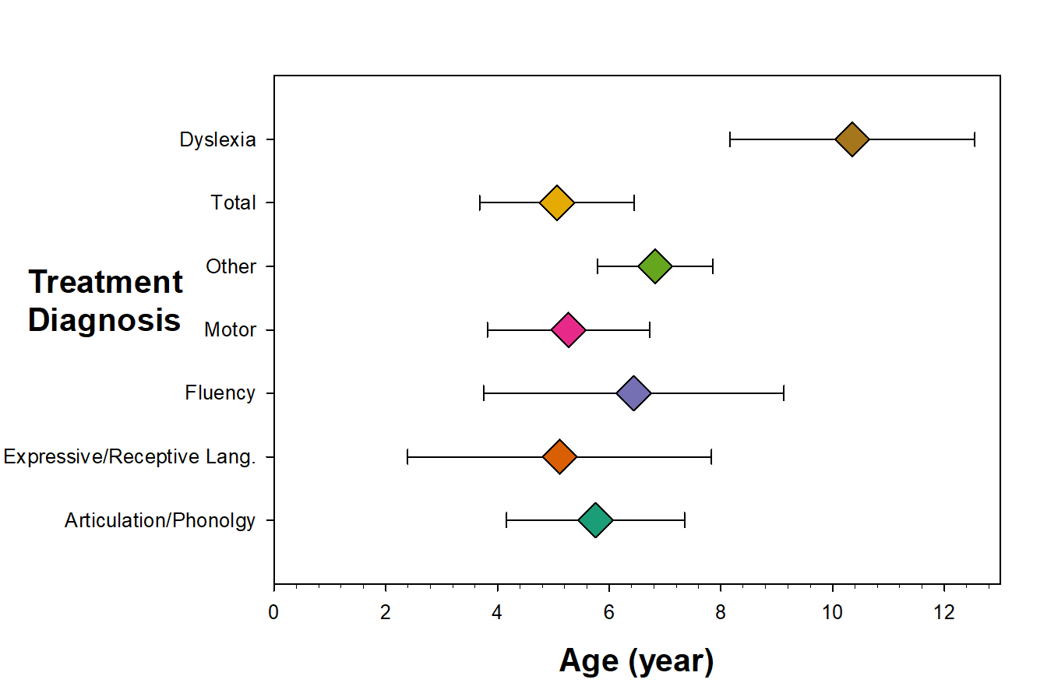
Average age by treatment diagnosis
Notes:
We have the responsibility, just like any other 3rd party payor, to report our outcomes to the SRF, we do this by reporting de-ID'd data. This data represents all RiteCare & Treasure Chest programs across the state of Colorado. The majority of children we serve for Speech therapy are under the age of 5. However, due to the age at which dyslexia is diagnosed, the average age of children who have dyslexia are 10 years of age.
MEAN (SD)
Articulation/Phonolgy 5.755479167 1.59534461
Expressive/Receptive Lang. 5.112666667 2.719735735
Fluency 6.437458333 2.687319949
Motor 5.270825 1.453565062
Other 6.824886656 1.037421216
Total 5.063311788 1.382204397
DysLexia 10.3511 2.19413

Slide 8
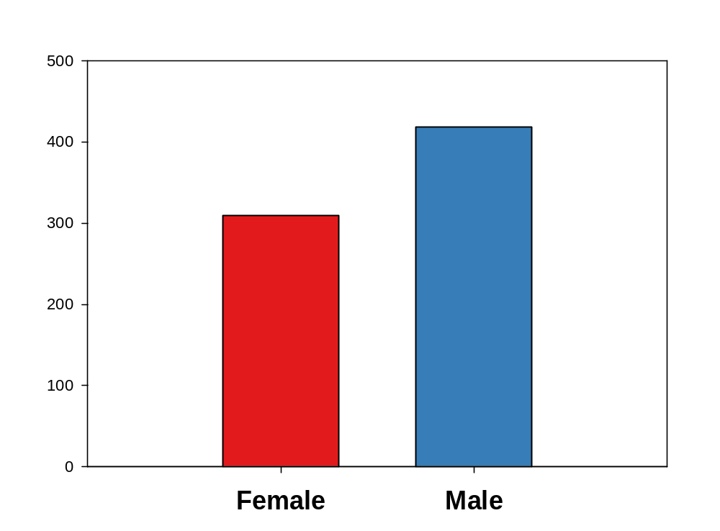
Notes:
MEAN
Female 309.0000000000000000
Male 418.0000000000000000

Slide 9
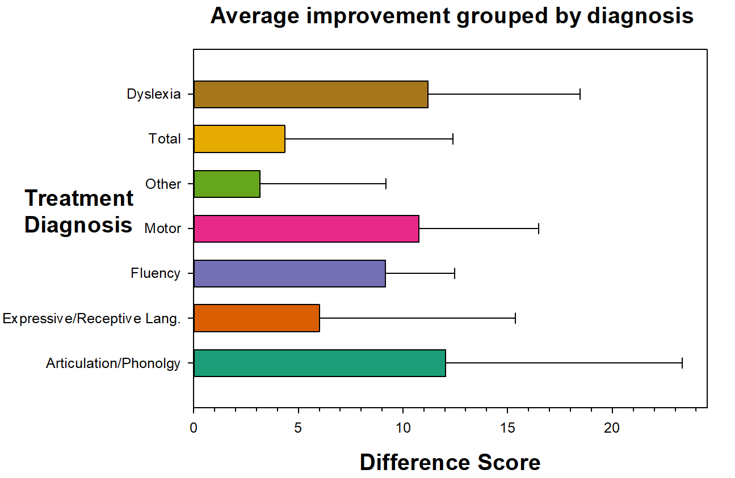
Notes:
In order to track benefit from therapy or performance over time, we compare the child’s performance prior to initiation of therapy and then in 6 month intervals. These data represent 6 months following the initiation of therapy. As you can see all children receiving speech therapy demonstrate marked improvement, with an average improvement from pre-to post of 5 points of improvement while some exhibit greater improvement in that time such as children with articulation challenges versus children with “other” developmental delays.
Children with dyslexia on average demonstrate an average improvement of nearly 11 points between pre and post intervention. Highlighting the efficacy of the interventions being provided.
Mean SD
Articulation/Phonolgy 12.0312500000000000; 11.3207898200000000
Expressive/Receptive Lang. 6.0000000000000000; 9.3808315199999990
Fluency 9.1649999999999990; 3.3129307270000000
Motor 10.7500000000000000; 5.7373048260000000
Other 3.1714285700000000; 6.0023257670000000
Total 4.3524669600000000; 8.0390584190000000
Dyselxia 11.2000000000000000; 7.2593896680000000

Slide 10
Community Benefit Grants
Aim: To encourage RiteCare Partners to engage more fully in parent education and/or family community language and literacy enrichment programs
Funded 9 Community Benefit Grants ($18,742)
Due to COVID-19 and challenges completing the CBGs, outcomes to be shared June 30, 2021
Notes:
The aim of this program was to encourage RiteCare Partners to engage more fully in parent education and/or family and community language and literacy enrichment programs. These programs would be offered at no charge to all families in the partners community regardless of healthcare Insurance or economic status
Successful applicants: submitted grants themed around
Parent education
Sign Language Classes
Dyslexia education Series
Community Education
Speech and language
Speech and language screenings in the community and/or daycare settings
Camps
Social Skills
RiteCare Program Grant Request Subject Area Amount Requested Recommended CSRC - Ft. Collins D. Boon* Understanding & improving abilities/skills Pre-literacy Development Parent Education 5000 5000 CHCO - S. Harendt Communication Development Support for Children with Tracheostomies Child & caregiver 853 1500 CHCO - L. Kendall Sign Language classes for parents and caregivers Parent Education 5000 5000 CHCO - Woeber & Dolan Augmentative & Alternative Communication basics for Parents Parent Education 853 853 CHCO - S. Robinson Colorado Springs Microtia/Atresia Family Education Event Parent Education 825 825 CHCO - Pathirana, Thorn, Stang Stuttering Nights / Parent Education Series Child & Parent Education 1300 1300 CHCO - J. Erickson Community Education Series on Dyslexia Parent Education 1010 1010 Pinon Project - Cortez Day Camp for Children with Special Needs & Families at Medicine Horse - Therapeutic Riding Facility Children & Family 2254 2254 Gunnison Valley Hospital** $18,742 Parent & Caregiver Education 1000 1000
New due dates: June 10, 2019 CHCO
Applications for 2019 - 2020 grants will be due by July 8, 2019.

Slide 11
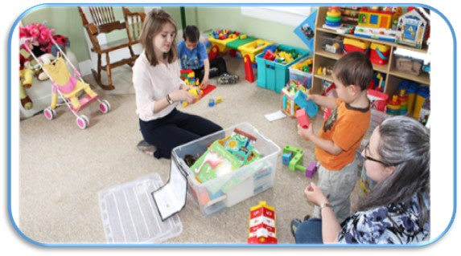
RiteCare Colorado
Children served in 2020 – 862
1953-2020 – 22,716
CHC (1953-2020) – 13,273
Partner Expansion (1986-2020) – 9,443
Treasure Chest

Slide 12
Graduate Scholarships
2020
Recipients: 6
Total Award Amount: $30,000
2003 – 2020
Recipients: 82
Total Award Amount: $410,000
Notes:
It is a pleasure to work with a board of trustees committed to the care of future generations of children. To ensure this future, the SRF awards graduate student scholarships to well-qualified second year grad students in SLP at our state’s 2 graduate training programs, UNC and CU.

Slide 13
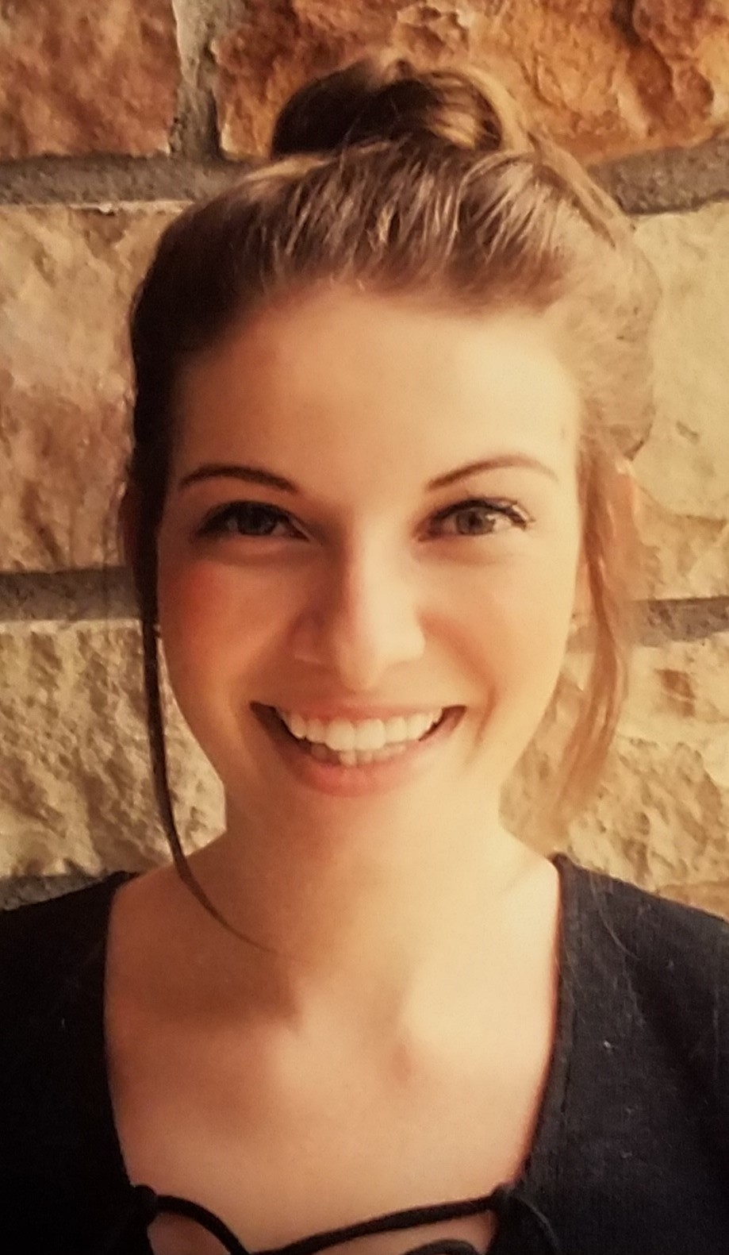
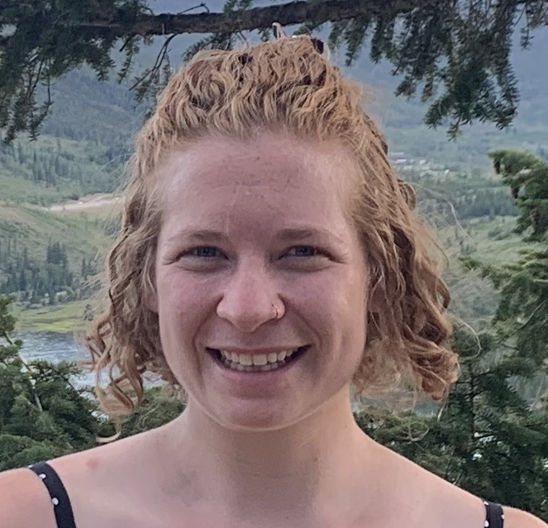
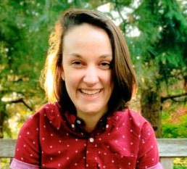
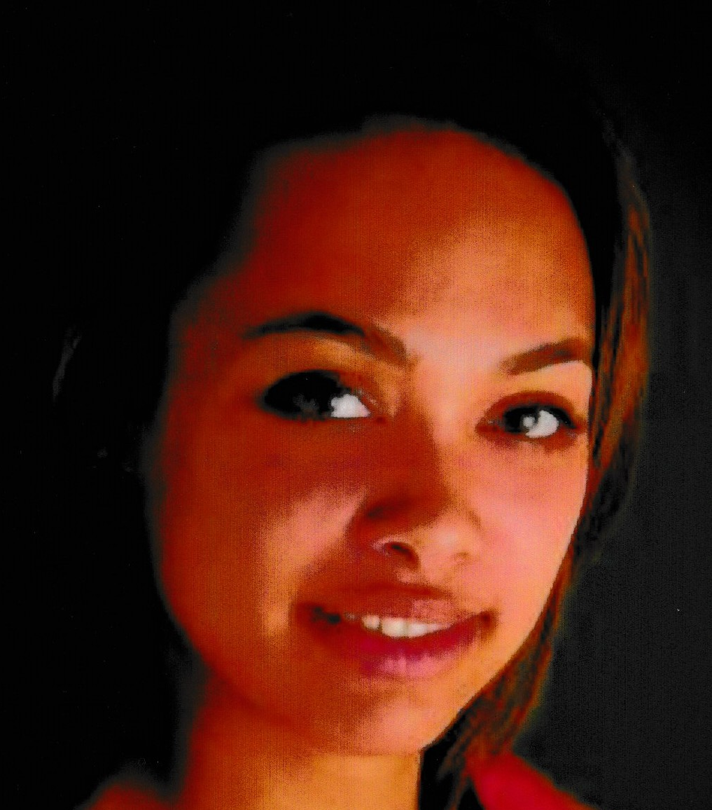
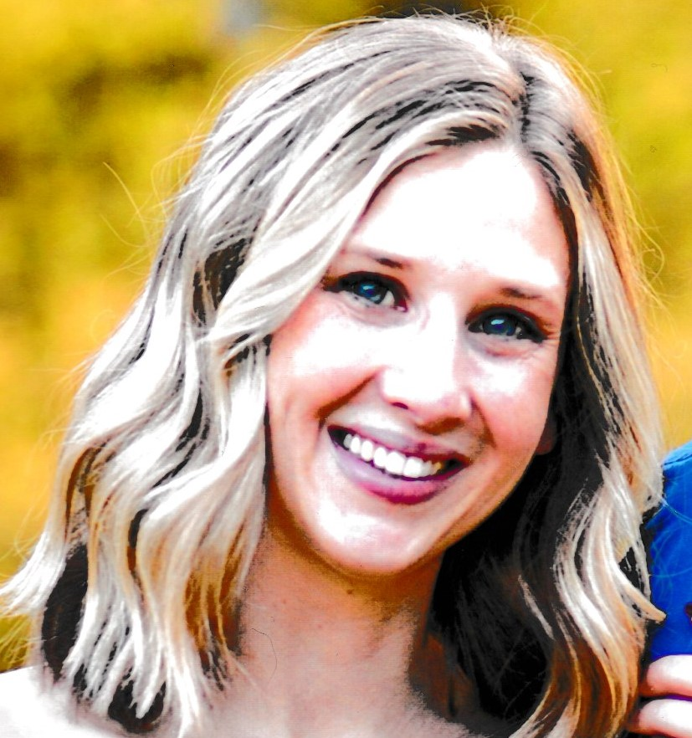
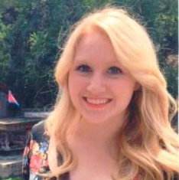
2020 – 2021 Scholarships Awarded
Dwight A. Hamilton Graduate Student Scholarship in Speech-Language Pathology
Amanda Joyce Barker
CU - Boulder
Celia Horowitz
CU - Boulder
Laura Petty
CU - Boulder
Blair Whiteside
UNC - Greeley
Ensuring care for children now and in the future.
Jennifer Bjoin
CU - Boulder
Jessie O’Brian
UNC - Greeley
Notes:
The merit-based scholarship program was initiated in 2003, to date 82 students have received $5,000 scholarships.
This year the Dwight A. Hamilton scholarships were awarded to 2 students from the University of Northern Colorado and 4 students from the University of Boulder.
Celia Horowitz is a second year Speech-Language Pathology graduate student at University of Colorado Boulder. Celia is originally from Brooklyn, NY and attended Tulane University, receiving a B.S in Psychology. Celia hopes to become an early interventionist and continue supporting Colorado children and their families
Laura Petty is from Fort Collins, Colorado. She received a BS in Communication Sciences and Disorders and Psychology from Northwestern University in Evanston, Illinois and is now a second year Speech-Language Pathology graduate student at University of Colorado Boulder. Laura plans to remain in Colorado to work with preschool or school-age students in a public-school setting.
Jennifer Bjoin is a second-year graduate student studying speech-language pathology at the University of Colorado Boulder. She attended Drake University in Des Moines, IA. Jennifer aspires to practice in Colorado as an SLP for the pediatric population, specializing primarily in language, literacy, voice, and pragmatics.
Amanda Joyce Barkley is a graduate student in the MA-SLP program at CU Boulder. She graduated with her B.A. in Speech Language Hearing Sciences (SLHS) with minors in Theater and in Linguistics from CY Boulder in December 2018. Amanda knows she will work with children as an SLP, and her dream is to work at Children’s hospital with the amazing team of professionals there.
Blair Whiteside is a second-year graduate student in Speech-Language Pathology at the University of Northern Colorado. Having taken a more non-traditional path in the field of Speech-Language Pathology, Blair’s initial interest in this field began when she was pursuing both a bachelors and master’s degree in voice performance. Blair looks forward to completing her studies at the University of Northern Colorado and beginning her career as a speech language pathologist in the Denver area.
Jessie O’Brian is a second-year graduate student in Speech-Language Pathology at the University of Northern Colorado. After completing a degree in Film in Los Angeles, Jessie was a nontraditional student who moved to Colorado and completed her undergraduate coursework at UNC. Jessie hopes to work in a hospital or private practice in pediatrics in Colorado.

Slide 14
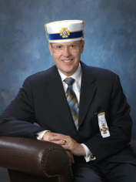
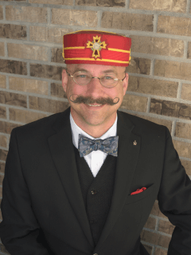
RiteCare Program Changes in 2020
L. Bryant Harris, 32°, KCCH
Executive Secretary
Vernon B. Ingraham, 33°, GC
Executive Secretary 2000-2020
Notes:
I would now like to turn the podium over to Bryant
Thank you Dr. Uhler
One of the first presentations I saw from Vern, several years ago, was about the impact that RiteCare has on our families, our community and the state at large.
Please remember that the numbers Dr. Uhler and I present today are not mere statistics, they represent very real children, and only children. We don’t keep a statistical record of the care givers, family members and friends impacted by the amazing work of the Scottish Rite Foundation partners. At a minimum you could double those numbers to estimate the impact, but I still believe that would be a vast underestimate.

Slide 15
RiteCare Colorado
Clinic Program Support
2020 - $1.45 million
1953-2020- $43.7 million
CHC (1953-2020) - $29.6 million
Partner Expansion (1986-2020) - $14.1 million
Notes:
In the last 67 years, the Scottish Rite Foundation has supported programs totaling 43.7 million dollars. Outreach has gown in many areas such as the Treasure Chest Programs and Community Benefit Grants.
Services have expanded to include some Learning Therapies, particularly for children struggling with Dyslexia. The growth in need has pressed the board hard to manage funds in the most efficient ways possible. We are thankful for the continuing support of the Rollie R. Kelley Family Foundation and the Schlessman Family Foundation.

Slide 16
RiteCare Colorado
Net Assets
12/31/2020
$34.5 million
Notes:
The founders of the Scottish Rite Foundation had a vision “that all Colorado children with language disorders will have the opportunity to receive treatment and care.” The board has carried that vision forward through careful stewardship of the donations received over these last 67 years. Your donations have helped to create a fund which continues to grow, providing for consistent annual returns which form a cornerstone for the budget which supports that mission. The needs of Colorado’s children, however, outpace the market. To meet that need the Scottish Rite Foundation continues to seek donations.

Slide 17
Reaching Out/Lifting Up Campaign
(with special emphasis on programs addressing parent education,
ASD, AAC, stuttering, & home-centered Treasure Chest)
Campaign Goal
$1,000,000
Donations & Bequests
$1,045,831.33
Notes:
In 2019 Vern and the board began a fundraising campaign with a special focus on
Parent Education
Autism Spectrum Disorder
Augmentative and Alternate Communication
Stuttering and the Treasure Chest Program
Thanks to the gifts of nearly 500 donors, the campaign exceeded it’s one million dollar goal.
As noted earlier, while 862 children received services this year and nearly 23,000 over the last 67 years, the impact of your donations is much more far reaching. Helping children to communicate strengthens our community and their personal contributions to the world because they can communicate, is immeasurable.
At this time I would like to invite Dr. Uhler to join me at the podium for a special award.

Slide 18
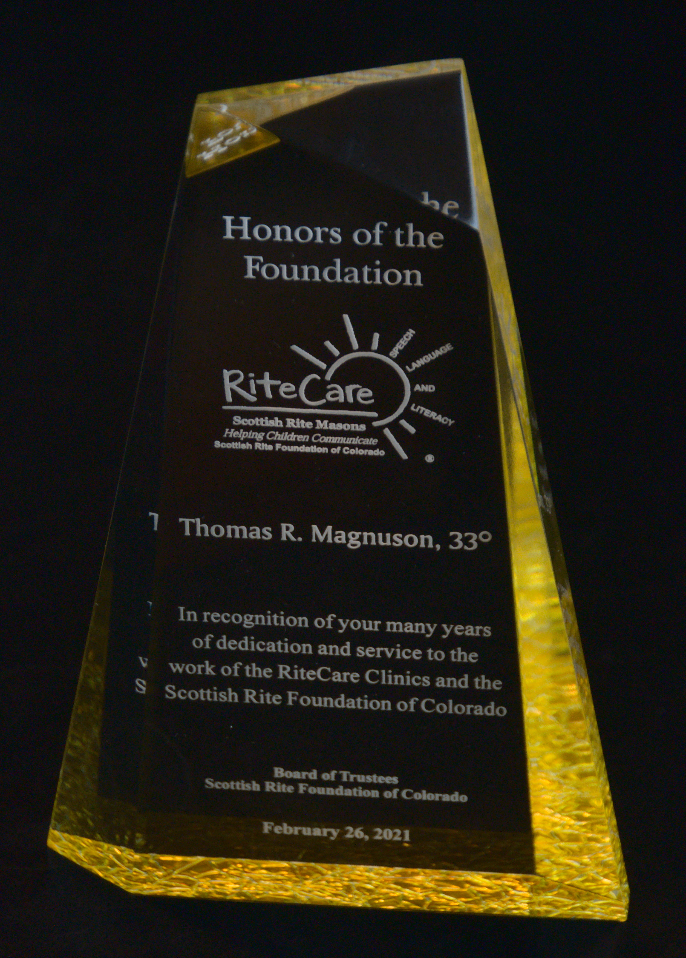
2020
Honors of the Foundation
Thomas R. Magnuson, 33°
Notes:
It is with great pleasure we announce that Tom Magnusson has been chosen to receive the Scottish Rite Foundation’s highest honor. Brother Tom and Brother Steve, could you please join us.
Tom has served on the board of the foundation for more than 20 years. His dedication to RiteCare, both in Colorado and in the Orient of Kansas, demonstrates his deep caring for children’s need to communicate. In his time with the foundation, Tom has witnessed and supported the transition of three executive secretaries, the hiring of the first Kelley Family/Schlessman Family Scottish Rite Masons Chair in Childhood Language Disorders, Dr. Deborah Hayes, then the transition to Dr. Kristin M. Uhler and the tremendous growth of services the Scottish Rite Foundation and its partners now provide. Tom’s tireless work to engage with our Colorado communities, particularly the team at the University of Northern Colorado, have earned him enormous appreciation and respect.
Tom, it is a great honor to present you this award.
[Bryant will invite Dr. Uhler and Tom to take seats at the table]
I would now like to offer the floor to the Honorable Illustrious Most Worshipful Steven M. Munsinger, Sovern Grand Inspector General Emeritus for the Orient of Colorado, President of the board.

Slide 19
CLOSING REMARKS
Judge Stephen M. Munsinger, 33º President
Scottish Rite Foundation of Colorado

